Slide 1
+25 dicas de performance tuning no SQL Server – Parte 3
SELECT "About me:"
FROM (VALUES('Fabiano Neves Amorim'),
('Data Platform MVP'),
('fabianonevesamorim@hotmail.com | @mcflyamorim'),
('https://www.facebook.com/fabiano.nevesamorim'),
('https://www.orkut.com/mcflyamorim'),
('http://blogfabiano.com')) AS Tab("About me:")

Slide 2
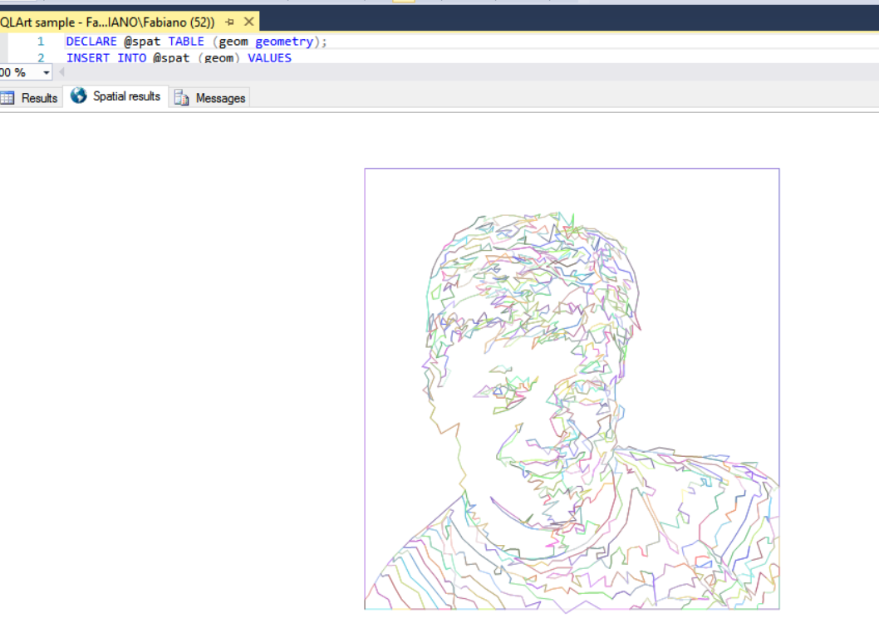




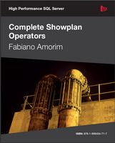




Fabiano Neves Amorim blogfabiano.com
BIOGRAPHY
Fabiano loves to conquer complex, challenging problems—especially the ones that others aren’t able to solve. He first became interested in technology when his older brother would bring him to his work meetings at the age of 14. With over a decade of experience, Fabiano is well known in the database community for his performance tuning abilities. When he isn’t working, he loves to read and spend time with his wife and kids.
facebook.com/fabiano.nevesamorim
Books
twitter.com/mcflyamorim
linkedin.com/in/fabianoamorim

